Slide 1

Exploratory Data Analysis
G2M insight for Cab Investment firm
9 August 2021

Slide 2

Agenda
Approach and Background
EDA & EDA Summary
Hypothesis testing
Recommendations

Slide 3
Approach and Background
XYZ is a private firm in US and due to remarkable growth in the cab industry in last few years and multiple key players in the market, it is planning for an investment in cab industry. We must summarize our analysis and recommendations and identify which company is performing better and is a better investment opportunity for XYZ.
The datasets were combined when necessary to create datasets to do the analysis.

Slide 4
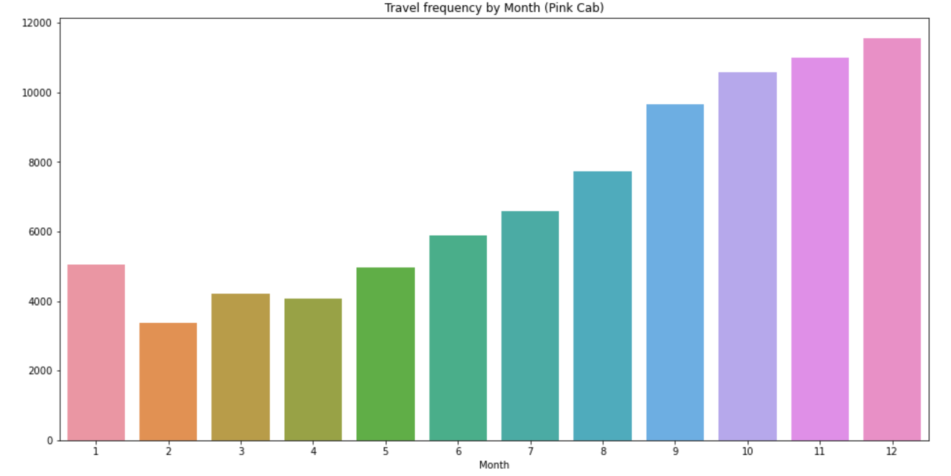
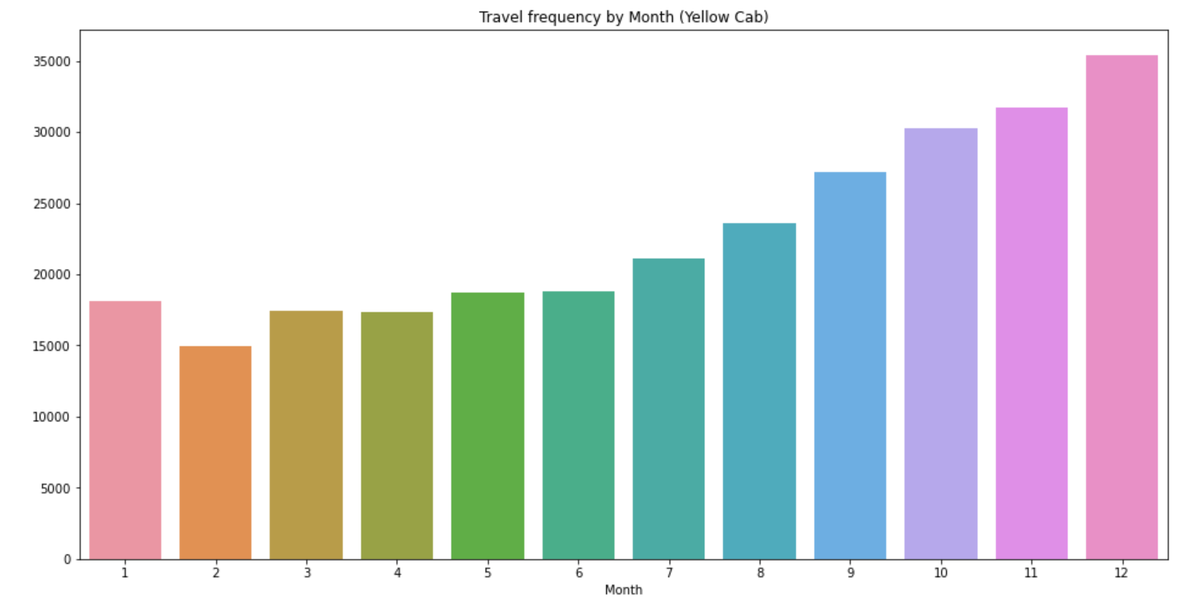
TRAVEL FREQUENCY
Here we can see that the travel frequency per month is more for Yellow when compared to Pink Cab. Specially towards the end of year in the months of November and December.

Slide 5
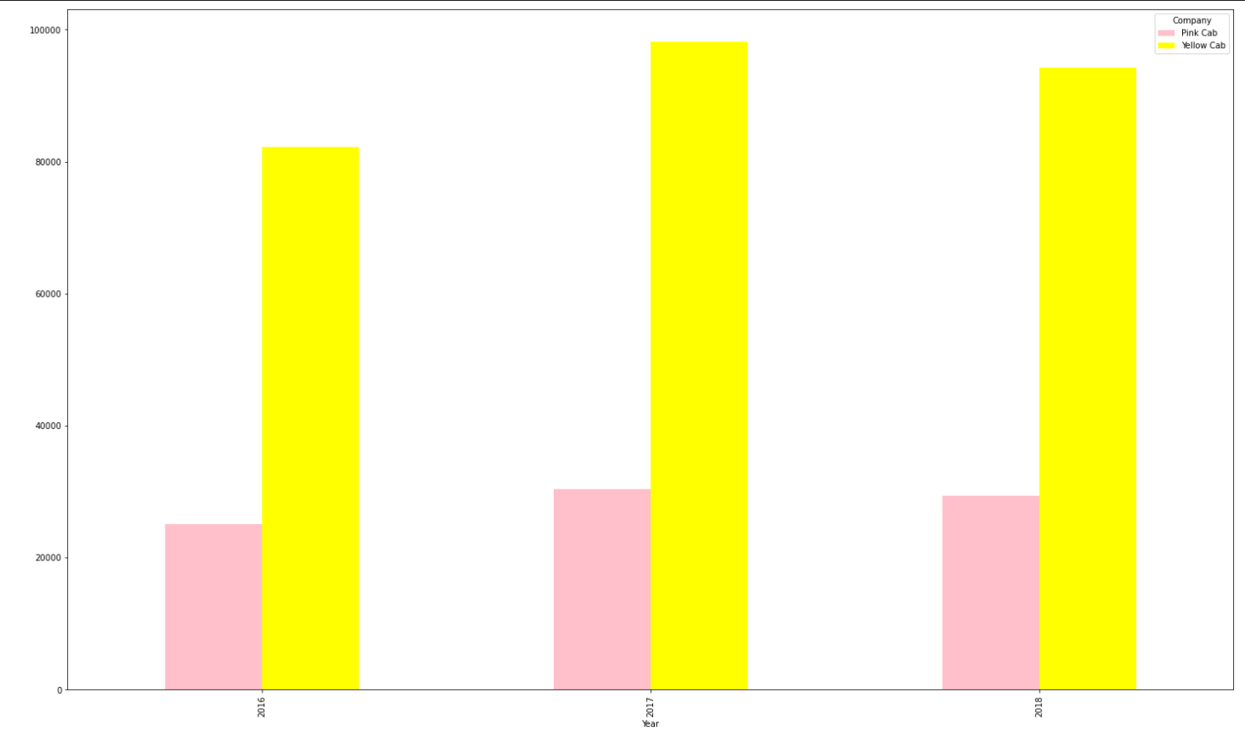
We can see that over the years, Yellow taxi has dominated in terms of usage but in 2018 dropped when compared to 2017.
Yearly Usage

Slide 6
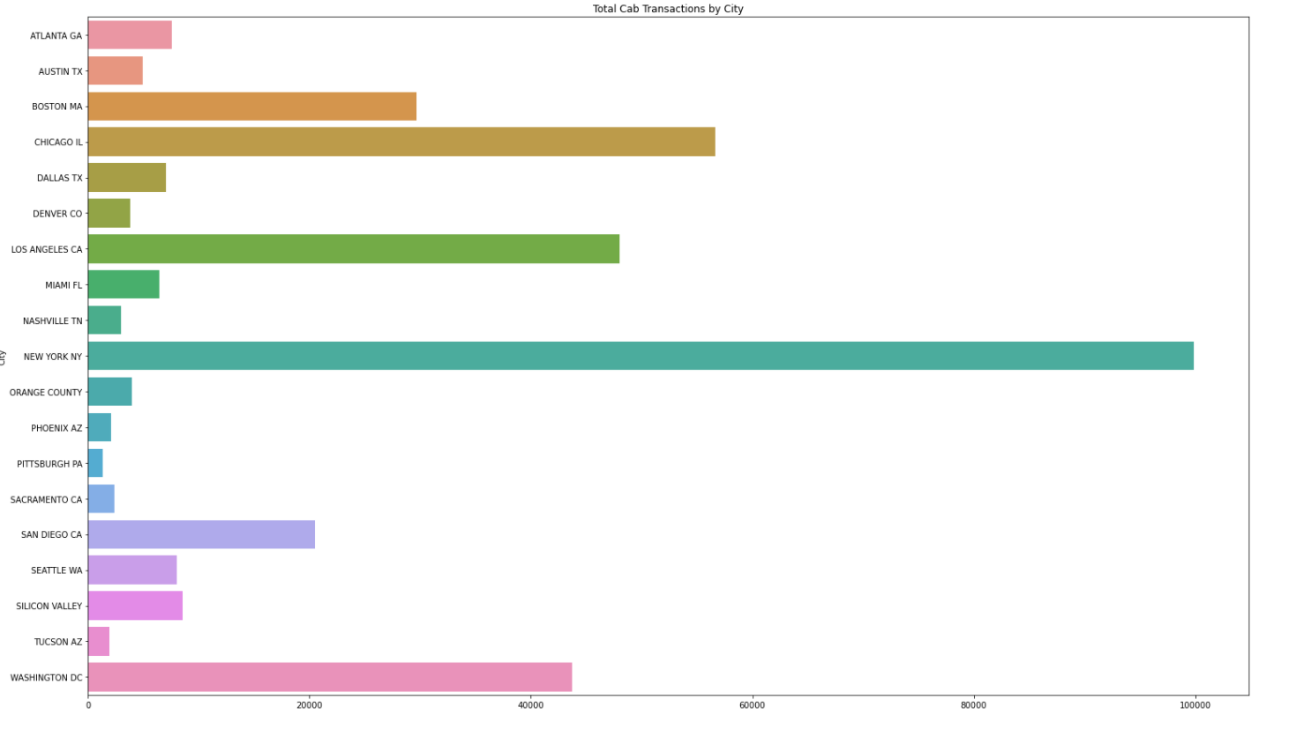
Total transactions divided by City
So, we can see that New York city was the city with most transaction(rides) comparatively.

Slide 7
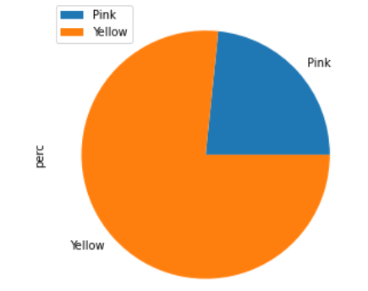
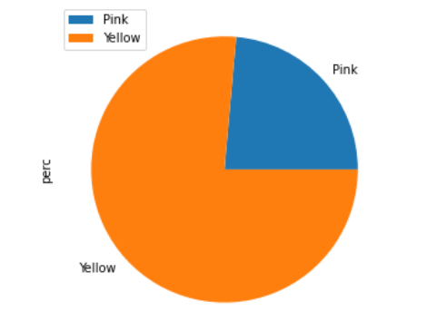
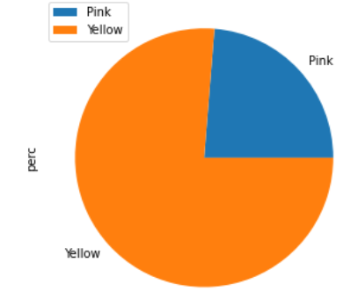
Percentage usage over the years
2016
2017
2018
over the years, the ratio remained almost same for the companies usage.

Slide 8
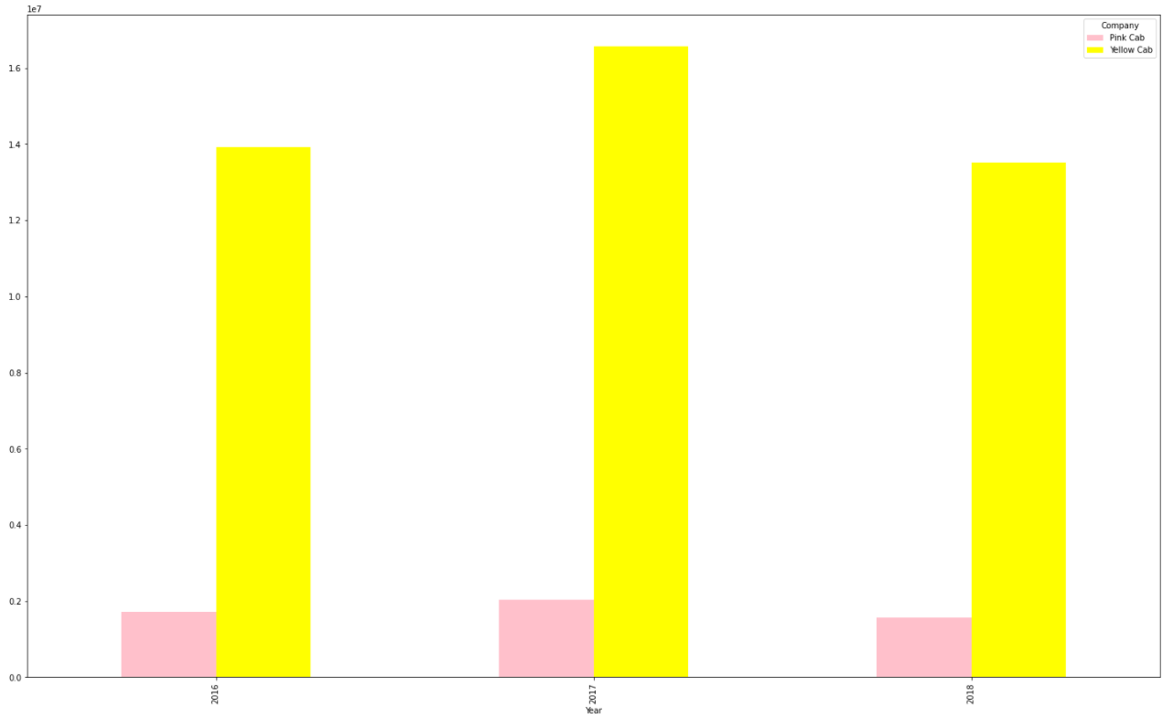
Profit share per year
Profit share has been dominated over the years by yellow cab

Slide 9
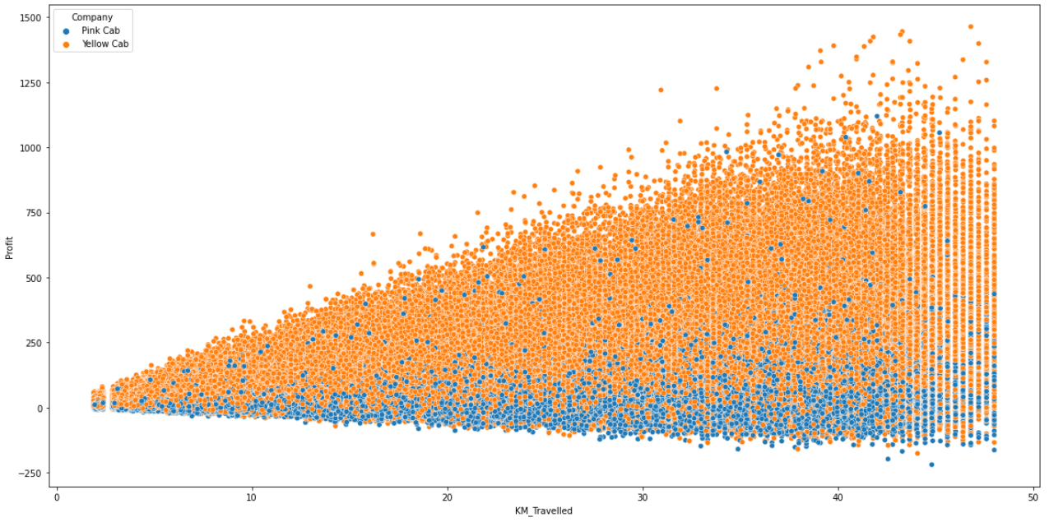
Relationship between Profit and Distance travelled
From the graph we can see that there is linear relationship between profit and distance for Yellow cab.

Slide 10
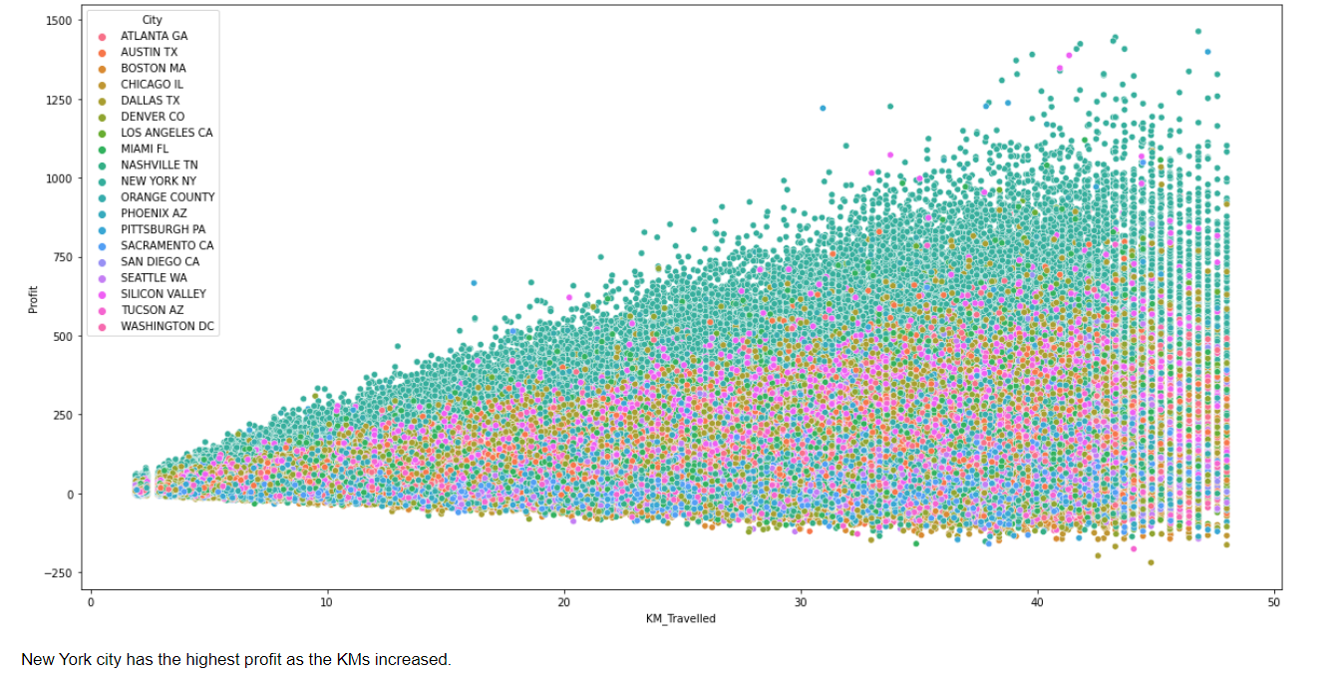
Relationship between Profit and Distance travelled per city

Slide 11
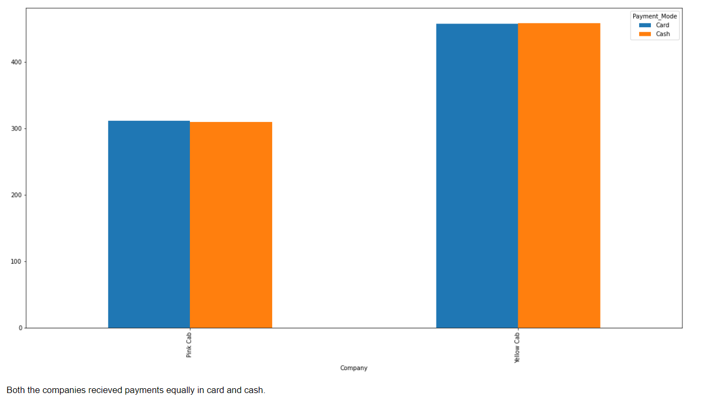
Type of payment for the different companies

Slide 12
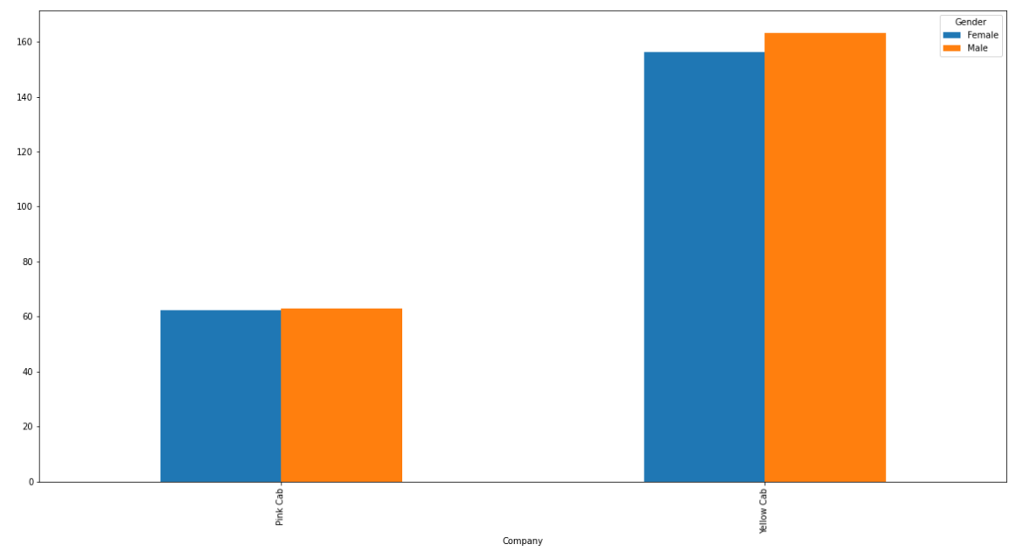
Profit generation based on gender across the two companies

Slide 13
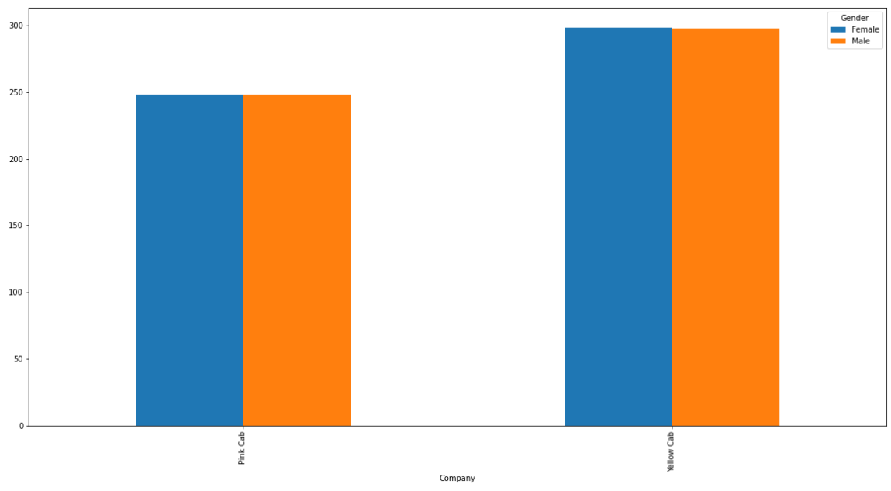
Cost of trip for the different genders across the two companies
The cost of trip is same for different genders in pink cab and almost same in yellow cab.

Slide 14
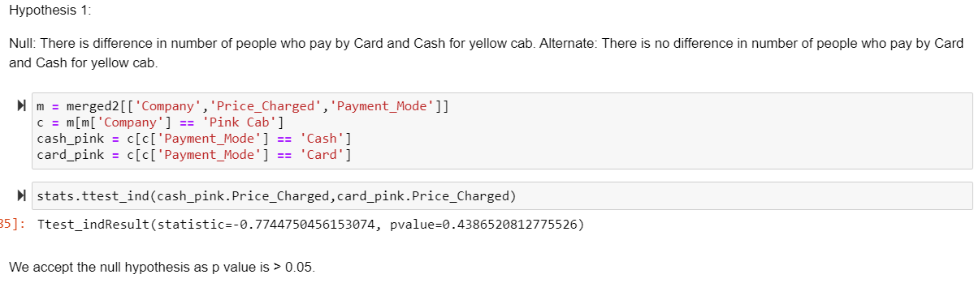
Hypothesis testing

Slide 15
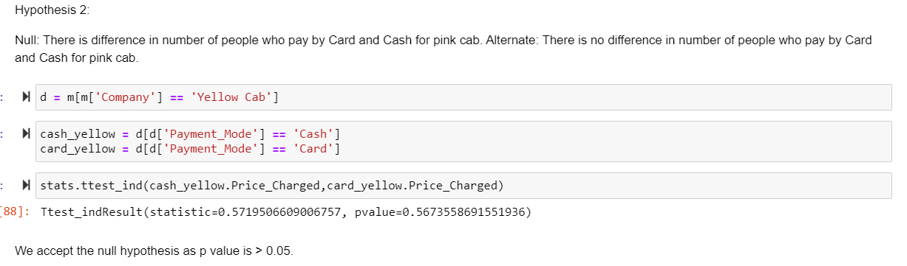
Hypothesis testing

Slide 16
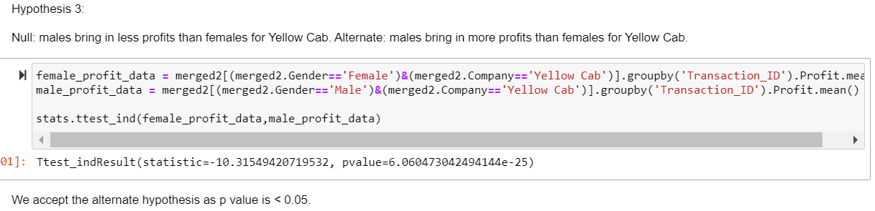
Hypothesis testing

Slide 17
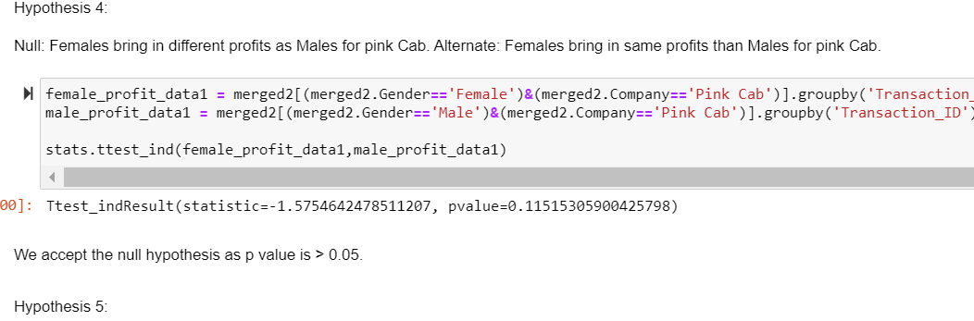
Hypothesis testing

Slide 18
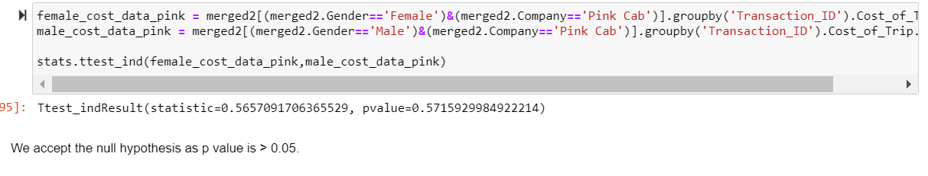
Hypothesis testing

Slide 19
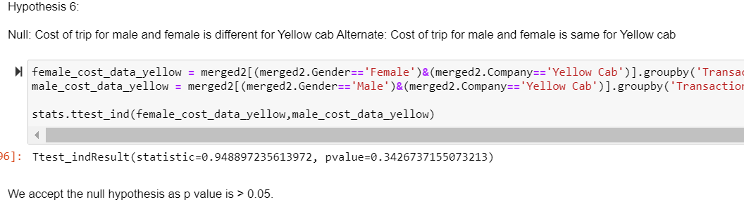
Hypothesis testing

Slide 20
Recommendations
Through the research and analysis done, I would recommend to invest in Yellow cab company as it has huge potential and has also dominated over the years in terms of usage and profit generation too.

Slide 21
Thank You

